Slide 1
Web Application Penetration Testing
Introduction to Web Applications
By Akshay

Slide 2
What is a Web Application?
A web application is a software application that runs on a web server and is accessed through a web browser. Unlike traditional desktop applications, web applications do not require installation on the user’s device.
What is a Web Application Server?
A web application server is a platform that handles application logic, database interactions, and the delivery of web content.
Examples: Apache Tomcat, Nginx, and Microsoft IIS.

Slide 3
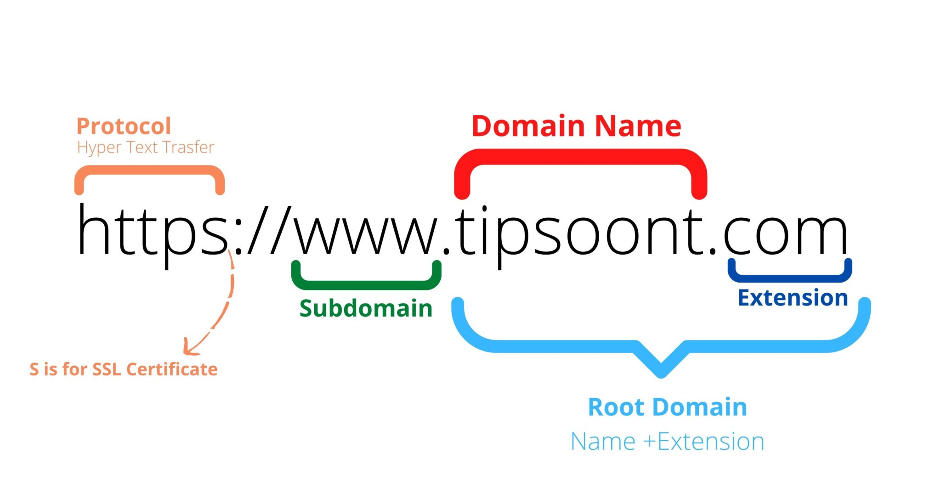
Fundamentals of a URL (Uniform Resource Locator)
A URL (Uniform Resource Locator) is the address used to access resources on the internet, such as web pages, images, and files. It consists of multiple components that define how to locate and retrieve the resource.
Components of a URL
Protocol (Scheme)
Examples: http, https
Example: https://
Domain Name (Host)
Can be a hostname (www.example.com) or an IP address (192.168.1.1).
Example: www.example.com
DNS
Port
Specifies the communication port on the server.
Default ports: 80 for HTTP, 443 for HTTPS.
Example: :443
Path
Indicates the specific resource or directory on the server.
Example: /blog/article
How URLs Work in Web Applications
User enters a URL → Browser sends an HTTP/HTTPS request.
DNS resolves the domain name → Translates it into an IP address.
Server processes the request → Returns the requested resource.
Browser renders the response → Displays content to the user.

Slide 4
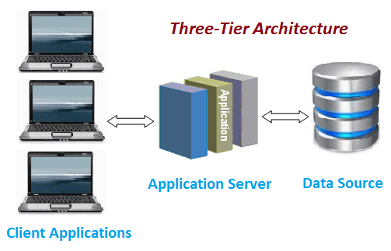
Terms Related to Web Applications
Client: The end-user device (browser) that interacts with the web application.
Server: The backend system that processes requests and serves responses.
Database: Stores user data, transactions, and application content.

Slide 5
Technologies Used in Web Apps
Frontend Technologies: HTML, CSS, JavaScript (React, Angular, Vue.js).
Backend Technologies: Node.js, Django, Flask, PHP, Ruby.
Databases: MySQL, PostgreSQL, Firebase, MongoDB.
Security & Performance: Web Application Firewalls (WAF), Content Delivery Networks (CDN).
Networking & APIs: Communication between frontend and backend via REST or GraphQL APIs.
Types of Web Applications
Static Web Apps: Simple pages with no interaction (e.g., portfolios, blogs).
Dynamic Web Apps: Apps that interact with a database (e.g., e-commerce sites, social media).

Slide 6
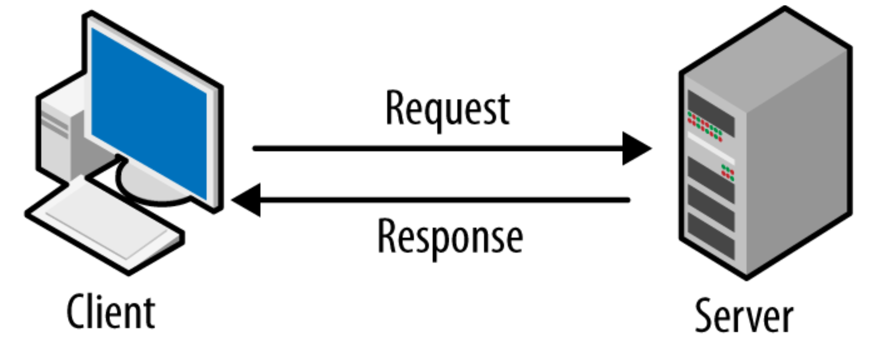
How Web Applications Work
User interacts with the web interface (frontend).
Browser sends requests to the server.
Server processes requests and interacts with the database if necessary.
The server returns a response to the client.
The browser renders the response for the user.

Slide 7
Exploitation of Dangerous HTTP Method
--------------------------------------------------------->
If you want to know which method are enabled, try to use 'OPTION'
OPTIONS → Retrieves the list of allowed HTTP methods on the server.
PUT → Allows storing an enclosed entity on the server (often used for file uploads, which can be exploited for web shell uploads).
GET → Retrieves information from the server (can be used to extract sensitive data).
HEAD → Similar to GET, but retrieves only the headers, without the response body.
POST → Sends data to the server, commonly used for form submissions and API interactions.
TRACE → Echoes back the received request, often used for debugging but can be exploited for XST (Cross-Site Tracing) attacks.
DELETE → Removes a specified resource from the server (can be dangerous if misconfigured).

Slide 8
Phases of Web Application Penetration Testing
1. Reconnaissance (Information Gathering)
Gathering initial information about the target application.
Passive Reconnaissance: WHOIS lookup, Google Dorking, Shodan, OSINT.
Active Reconnaissance: Subdomain enumeration, DNS lookup, banner grabbing.
Tools: Nmap, Sublist3r, Recon-ng, OSINT.
2. Scanning for Vulnerabilities
Identifying potential security flaws using automated and manual testing.
Automated Scanners: Burp Suite, HCL App Scan, Nikto, OWASP ZAP.
Manual Testing: Checking headers, cookies, parameters and every input field.
Directory Bruteforcing: dirsearch, gobuster, fuff.

Slide 9
Exploiting Web Vulnerabilities
SQL Injection (SQLi): Extracting sensitive database info.
Cross-Site Scripting (XSS): Injecting malicious scripts.
Broken Authentication: Bypassing login mechanisms.
Tools: sqlmap, Burp suite, XSS Hunter, wfuzz, hydra.
Reporting & Remediation
Documenting Findings: Categorizing severity (Critical, High, Medium, Low).
Providing Proof-of-Concept (PoC).
Suggesting Fixes & Best Practices.
Tools for Reporting: MS Word

Slide 10
cybersecurity standards and frameworks
OWASP Top 10: Open Web Application Security Project.
NIST Cybersecurity Framework (National Institute of Standards and Technology)
SANS CWE Top 25 (Common Weakness Enumeration)
CIS Controls (Center for Internet Security)

Slide 11
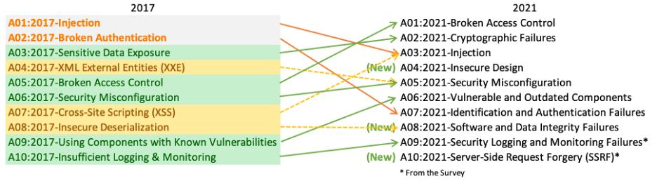
OWASP Top 10: a framework for web security
Open Web Application Security Project

Slide 12
1. Broken Access Control
🔹 What it is: When users can access things they shouldn’t, like viewing or modifying other users' data.
🔹 Example: A normal user can change their role to "Admin" by modifying a request in the browser's developer tools.
2. Cryptographic Failures (Previously: Sensitive Data Exposure)
🔹 What it is: Weak encryption or no encryption, leading to sensitive data being exposed.
🔹 Example: A website stores passwords in plain text instead of hashing them, making them easy to steal.
3. Injection
🔹 What it is: Attacker sends malicious input (like SQL, NoSQL, or LDAP) to manipulate databases or commands.
🔹 Example: A login form allows ' OR 1=1 -- as a username, bypassing authentication.

Slide 13
4. Insecure Design (New category in 2021)
🔹 What it is: Poorly designed security measures, leading to exploitable flaws.
🔹 Example: A banking app allows unlimited incorrect PIN attempts, making brute-force attacks easy.
5. Security Misconfiguration
🔹 What it is: Incorrect security settings that expose sensitive data or allow attackers to exploit weaknesses.
🔹 Example: A cloud storage bucket is public by default, exposing private files to anyone with the link.
6. Vulnerable and Outdated Components (Previously: Using Components with Known Vulnerabilities)
🔹 What it is: Using old software versions that have known security issues.
🔹 Example: A website uses an outdated version of jQuery that has known security vulnerabilities.

Slide 14
7. Identification and Authentication Failures (Previously: Broken Authentication)
🔹 What it is: Weak authentication mechanisms, allowing attackers to impersonate users.
🔹 Example: A site allows weak passwords like "123456" without enforcing password complexity rules.
8. Software and Data Integrity Failures (New category in 2021)
🔹 What it is: When applications update or load code from untrusted sources, leading to tampering.
🔹 Example: A website loads JavaScript from a third-party CDN without verifying its integrity, leading to malware injection.
9. Security Logging and Monitoring Failures (Previously: Insufficient Logging & Monitoring)
🔹 What it is: Not detecting or recording security events properly, making it hard to spot attacks.
🔹 Example: A company doesn’t log failed login attempts, making brute-force attacks undetectable.

Slide 15
10. Server-Side Request Forgery (SSRF) (New entry in 2021)
🔹 What it is: Attacker tricks a server into making unauthorized requests to internal resources.
🔹 Example: A web app allows users to fetch profile pictures via a URL but doesn’t validate input, allowing an attacker to request http://internal-company.com/secret.

Slide 16
Full Introduction to Burp Suite
What is Burp Suite?
Burp Suite is a comprehensive tool for web security testing, used by penetration testers to find and exploit vulnerabilities in web applications.
Key Features of Burp Suite
Proxy Interception: Modify and analyze HTTP requests.
Scanner: Automated vulnerability scanning.
Intruder: Fuzzing and brute-force testing.
Repeater: Manually modify and resend requests.
Burp collaborator:
Comparer:
Decoder & Comparer: Analyze encoded data and compare responses.

Slide 17
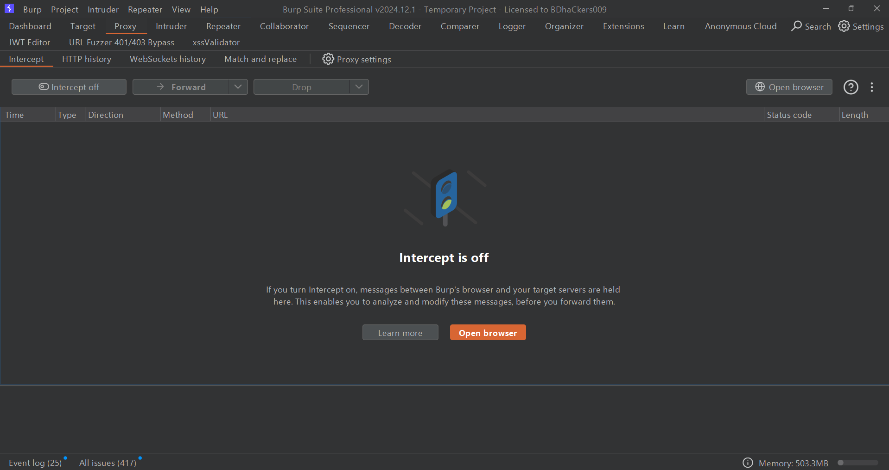

Slide 18
Live Demonstration
SQL Injection Exploit: Using sqlmap to extract database information.
Clickjacking:
CSRF:
SSRF:
XSS Attack: Injecting a script into a vulnerable input field.
Broken Authentication Exploit: Testing weak password policies.

